Slide 1
BUILDOTS UPDATE : 29/12/2019

Slide 2
SUMMARY
20 experiments were run on Colmap
Constant parameters : FPS (10), #Frames (295) , record lenght (30[s])
Parameters under test : Frame size, camera distance model, camera model
Bash script running multiple experiments
Notes:
#Frames and record length were increased compared to last experiment in order to begin and end the record slightly after the initial position
Without well defined error metrics, it is difficult to appreciate one experiment’s effectiveness without its dense reconstruction

Slide 3
EXPERIMENTS INDEX
FAR
1 FAR 1000 FOV
2 FAR 1000 SIMPLE_RADIAL_FISHEYE
3 FAR 1000 RADIAL_FISHEYE
4 FAR 1000 OPENCV_FISHEYE
5 FAR 1000 THIN_PRISM_FISHEYE
6 FAR 2000 FOV
7 FAR 2000 SIMPLE_RADIAL_FISHEYE
8 FAR 2000 RADIAL_FISHEYE
9 FAR 2000 OPENCV_FISHEYE
10 FAR 2000 THIN_PRISM_FISHEYE
CLOSE
11 CLOSE 1000 FOV
12 CLOSE 1000 SIMPLE_RADIAL_FISHEYE
13 CLOSE 1000 RADIAL_FISHEYE
14 CLOSE 1000 OPENCV_FISHEYE
15 CLOSE 1000 THIN_PRISM_FISHEYE
16 CLOSE 2000 FOV
17 CLOSE 2000 SIMPLE_RADIAL_FISHEYE
18 CLOSE 2000 RADIAL_FISHEYE
19 CLOSE 2000 OPENCV_FISHEYE
20 CLOSE 2000 THIN_PRISM_FISHEYE

Slide 4
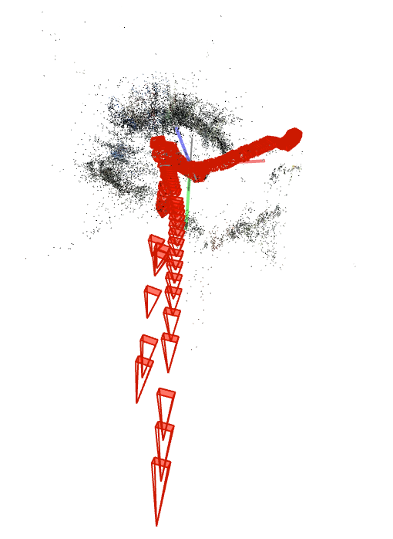
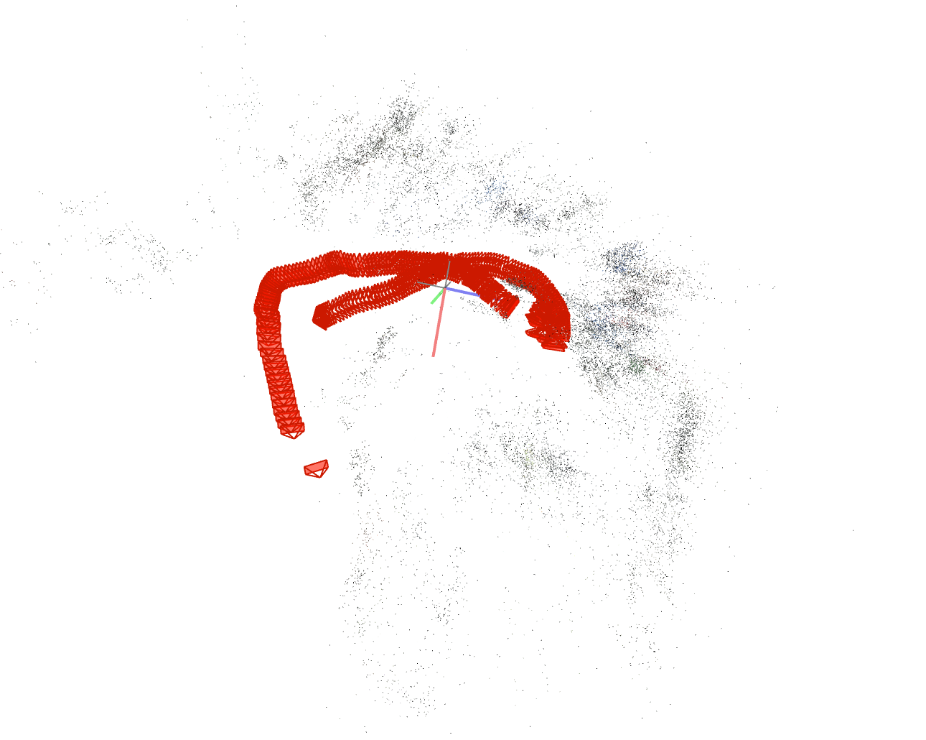
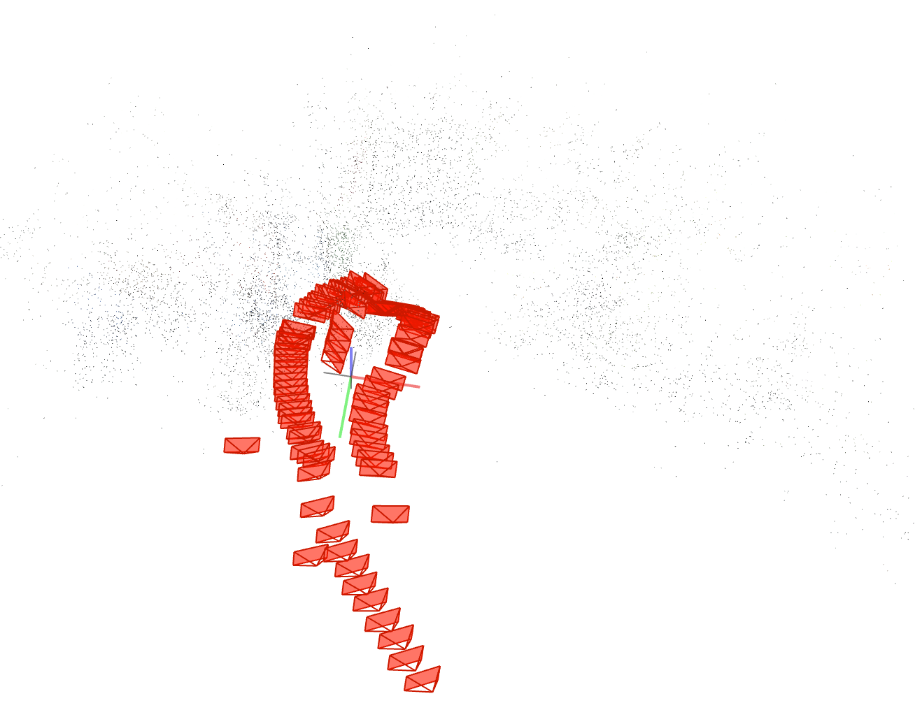
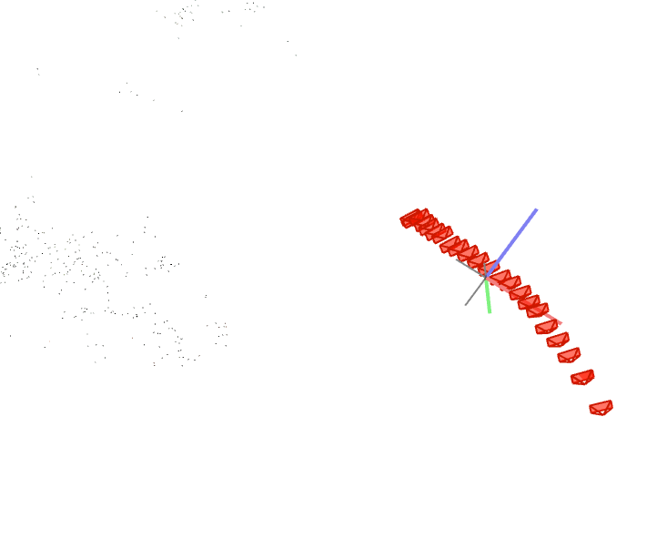
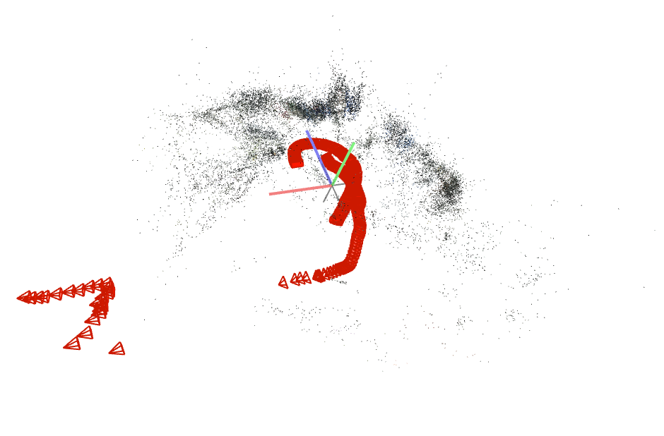
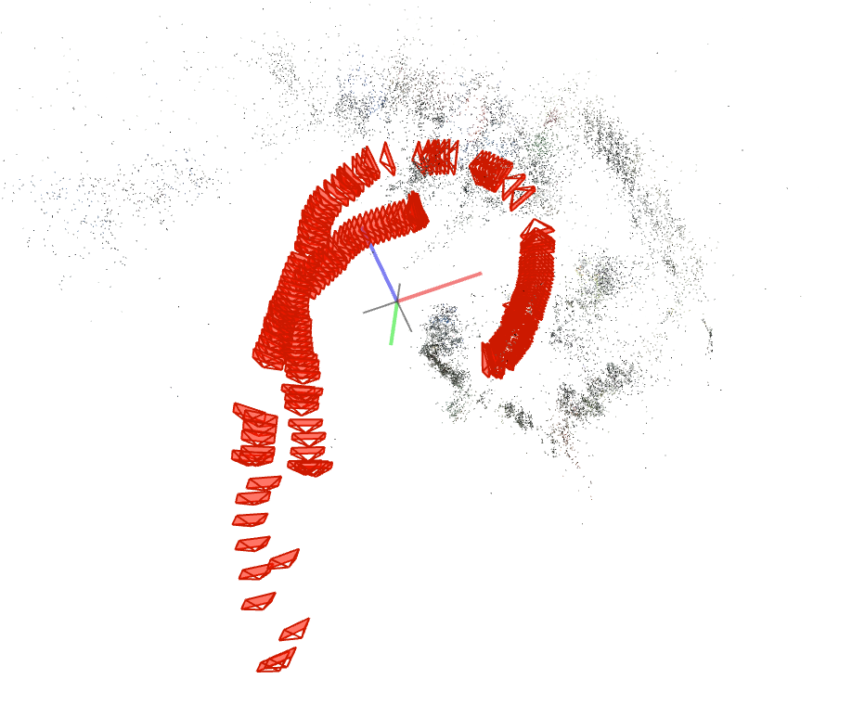
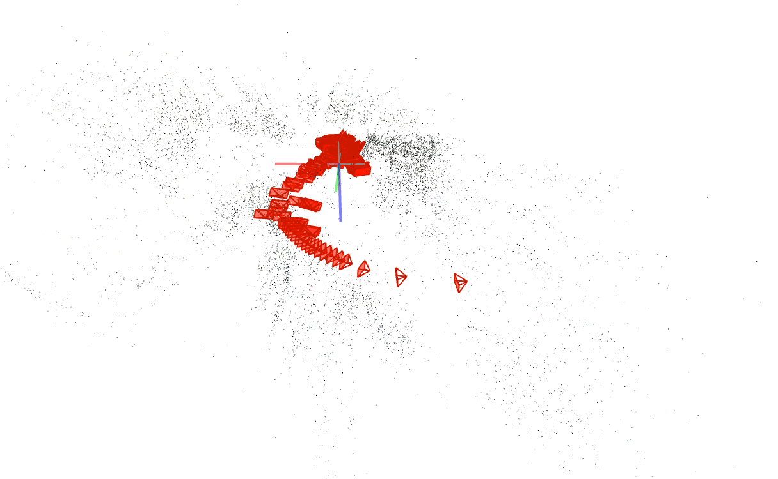
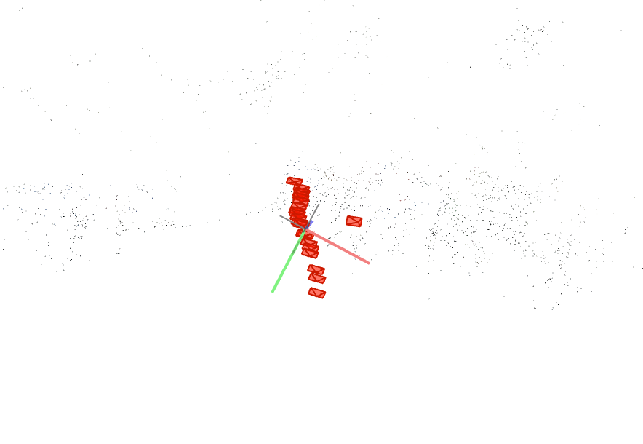
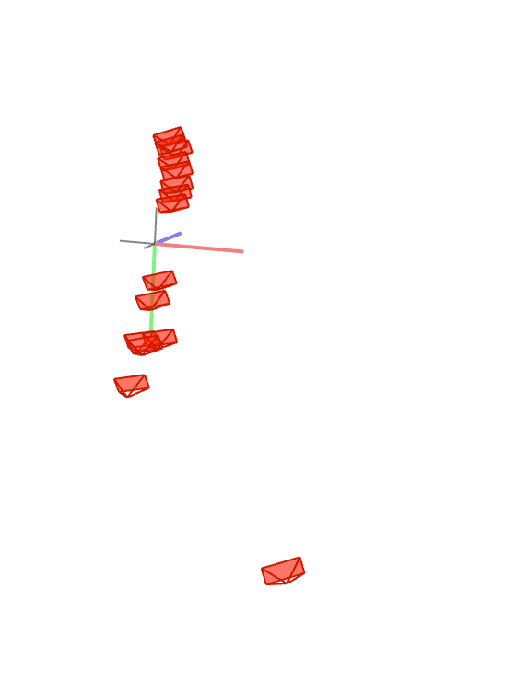
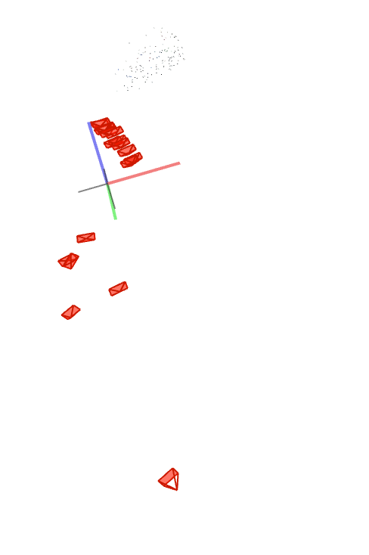
PREVIEW : FAR, 2000px
FOV 1 Sparse model | SIMPLE_RADIAL_FISHEYE 1 Sparse model | RADIAL_FISHEYE 1 Sparse model | OPENCV_FISHEYE 4 Sparse models | THIN_PRISM_FISHEYE 4 Sparse models

Slide 5
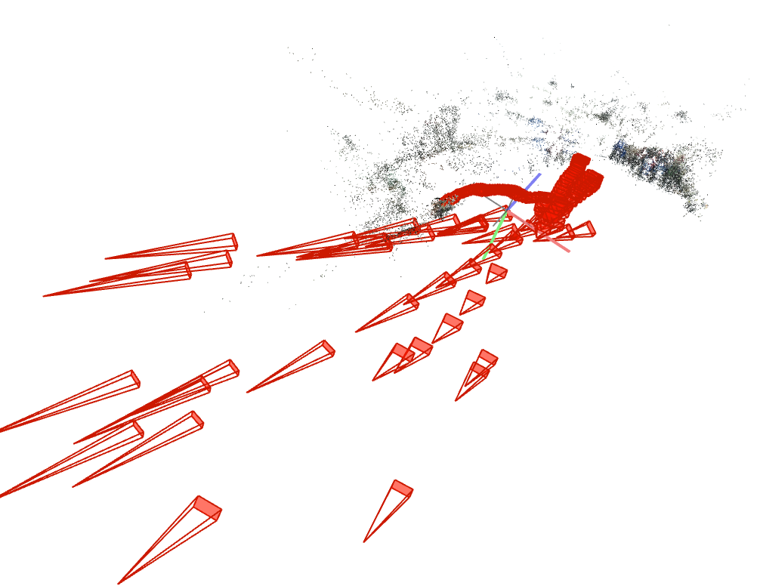
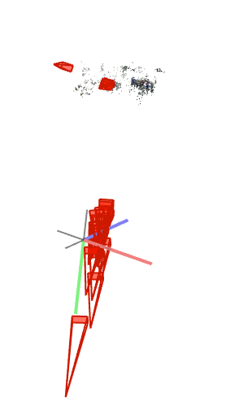
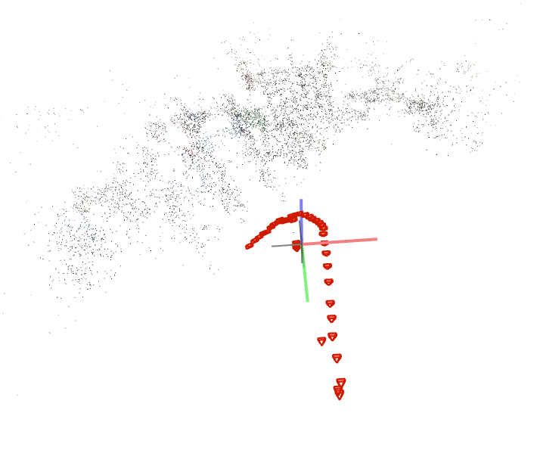
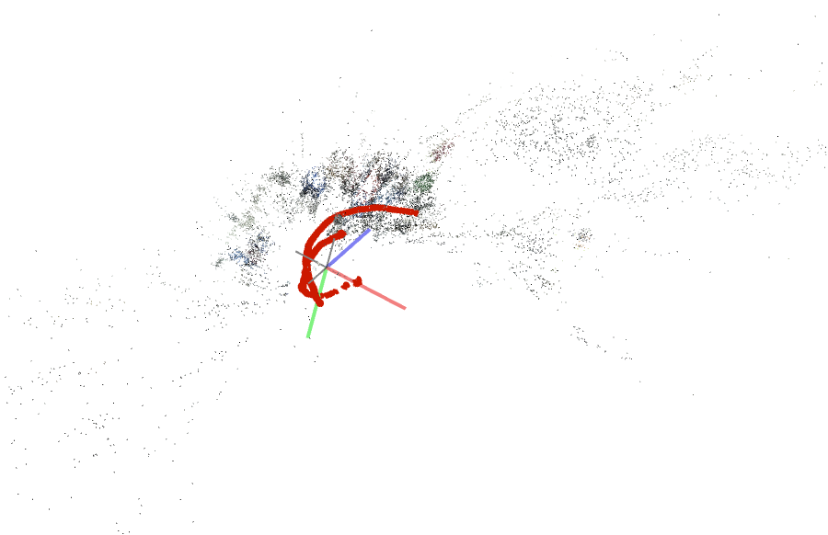
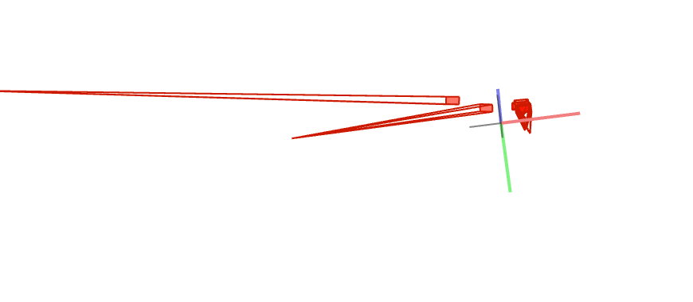
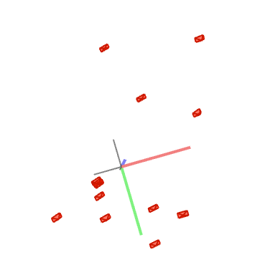
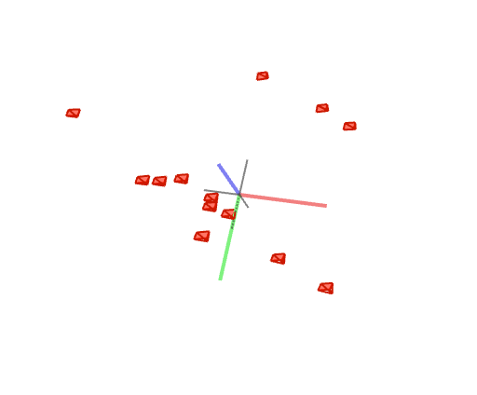
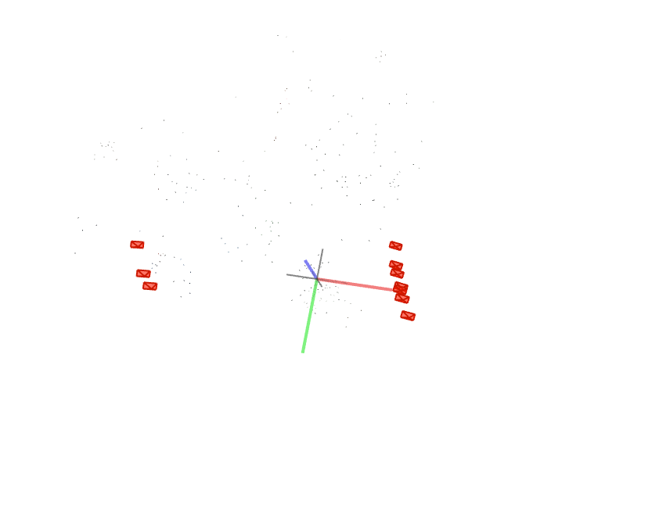
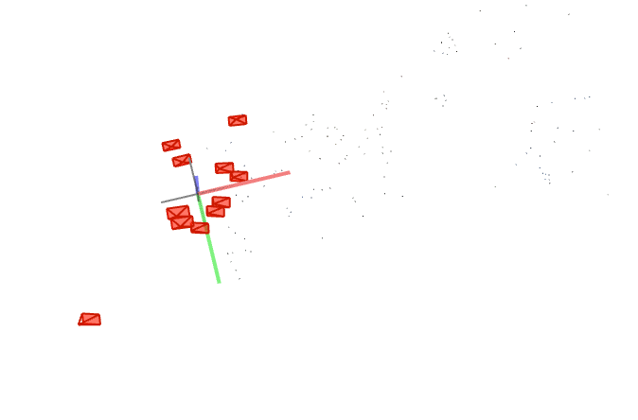
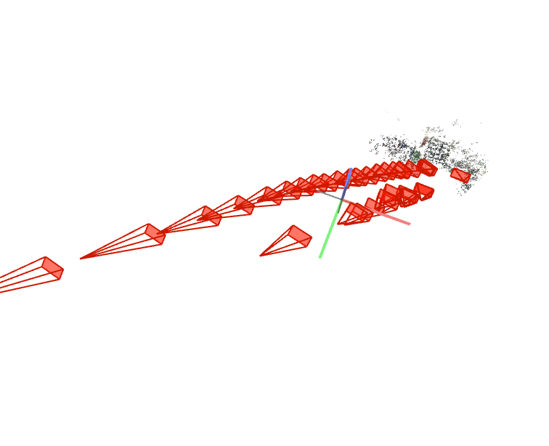
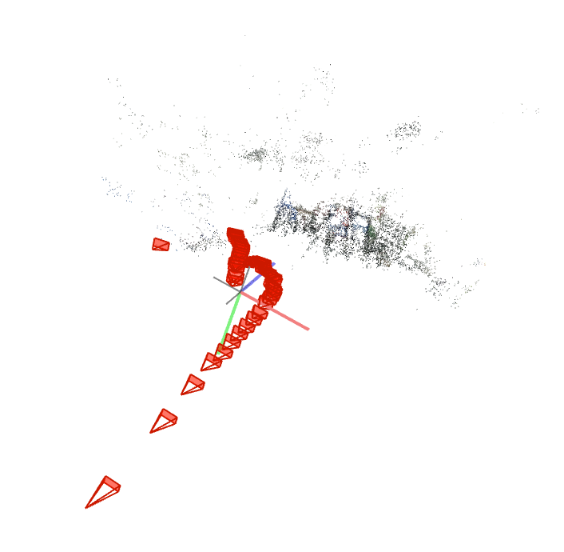
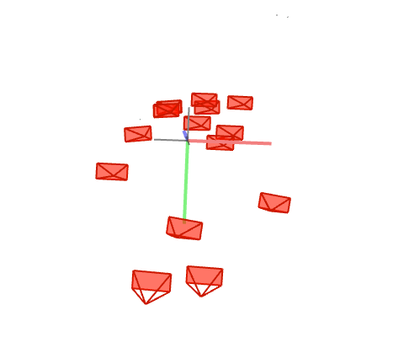
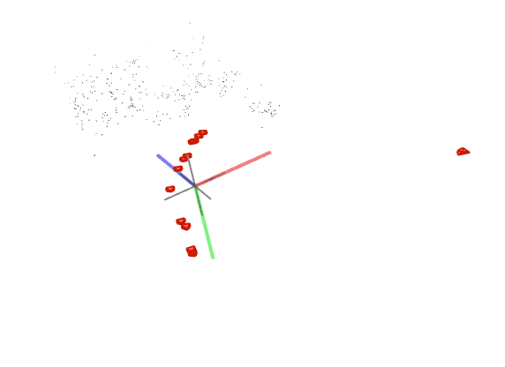
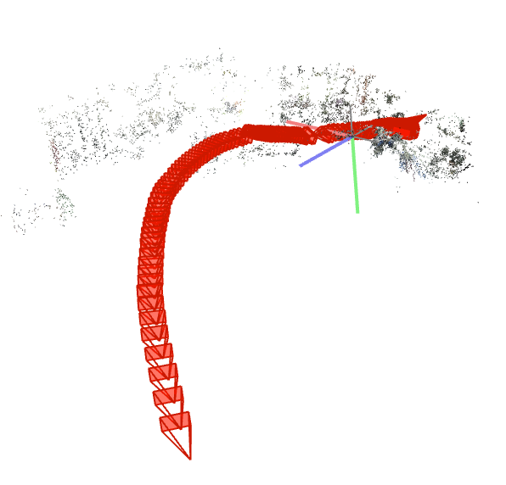
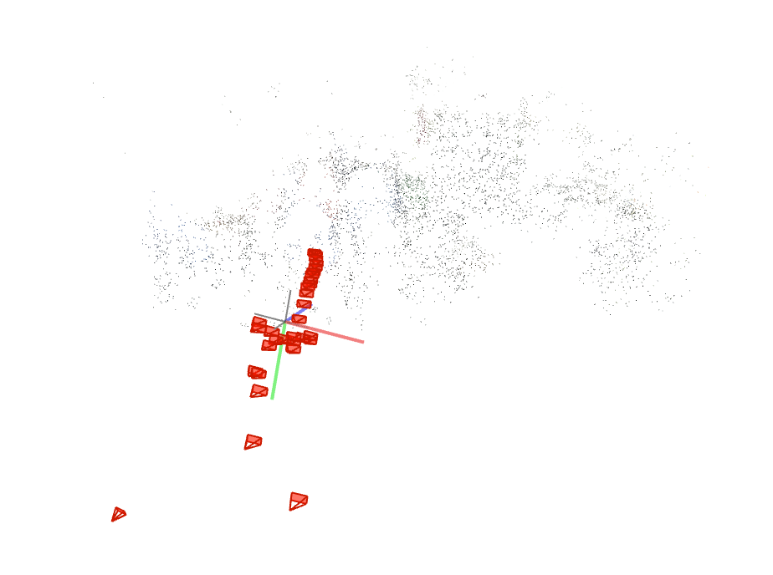
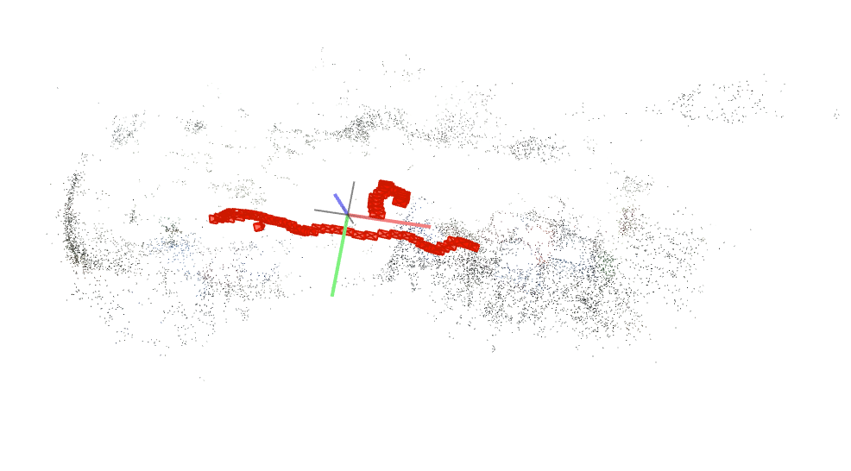

PREVIEW : FAR,1000px
FOV 5 Sparse models | SIMPLE_RADIAL_FISHEYE 2 Sparse models | RADIAL_FISHEYE 2 Sparse models | OPENCV_FISHEYE 7 Sparse models | THIN_PRISM_FISHEYE 1 Sparse model

Slide 6
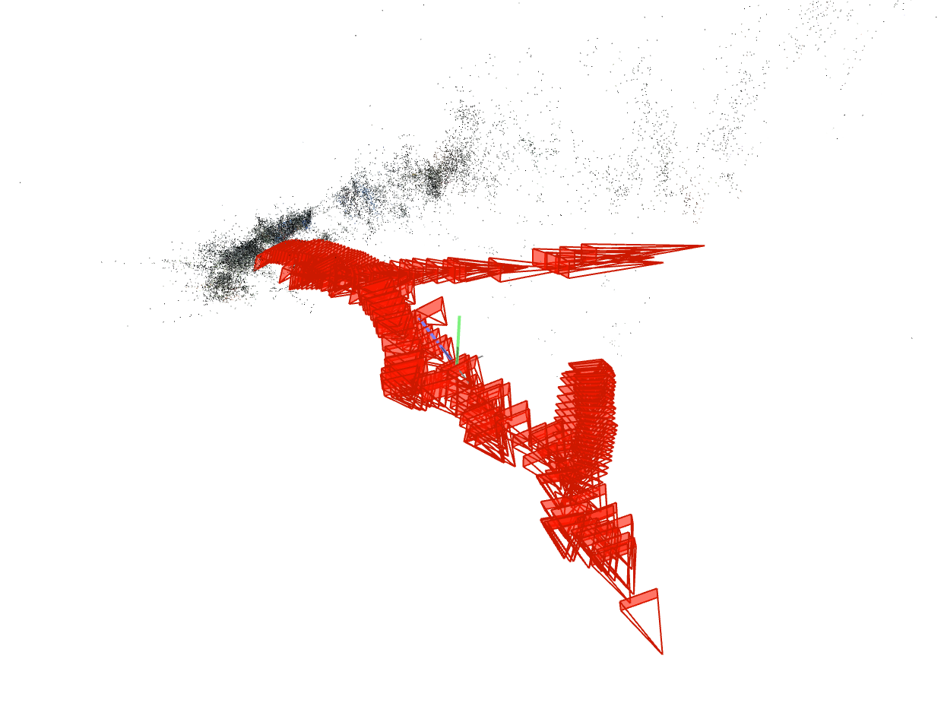
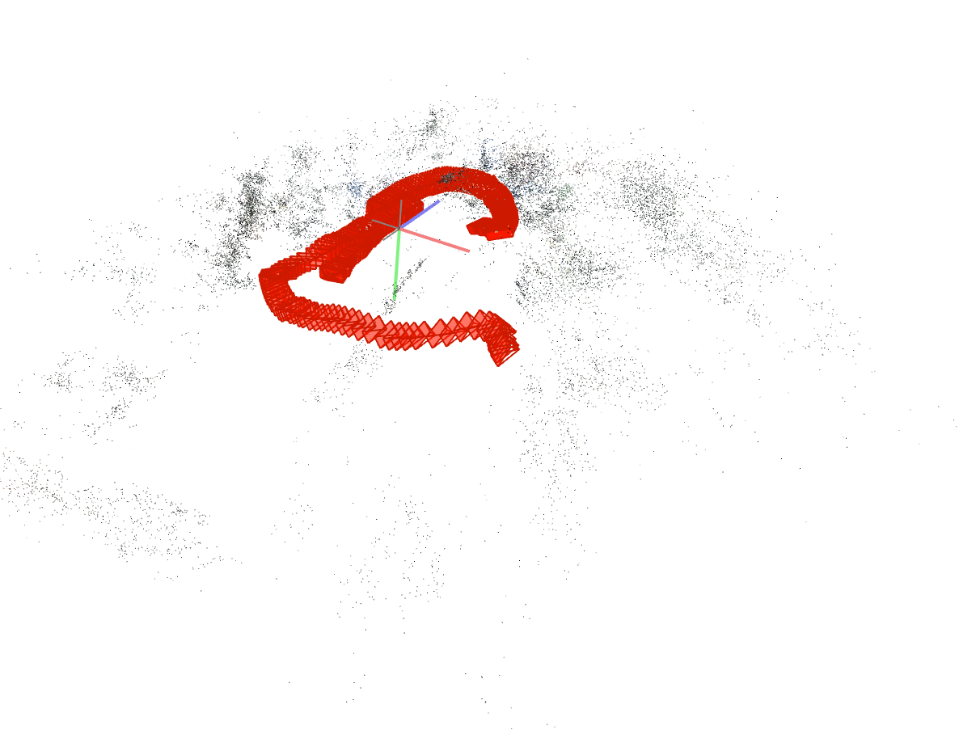
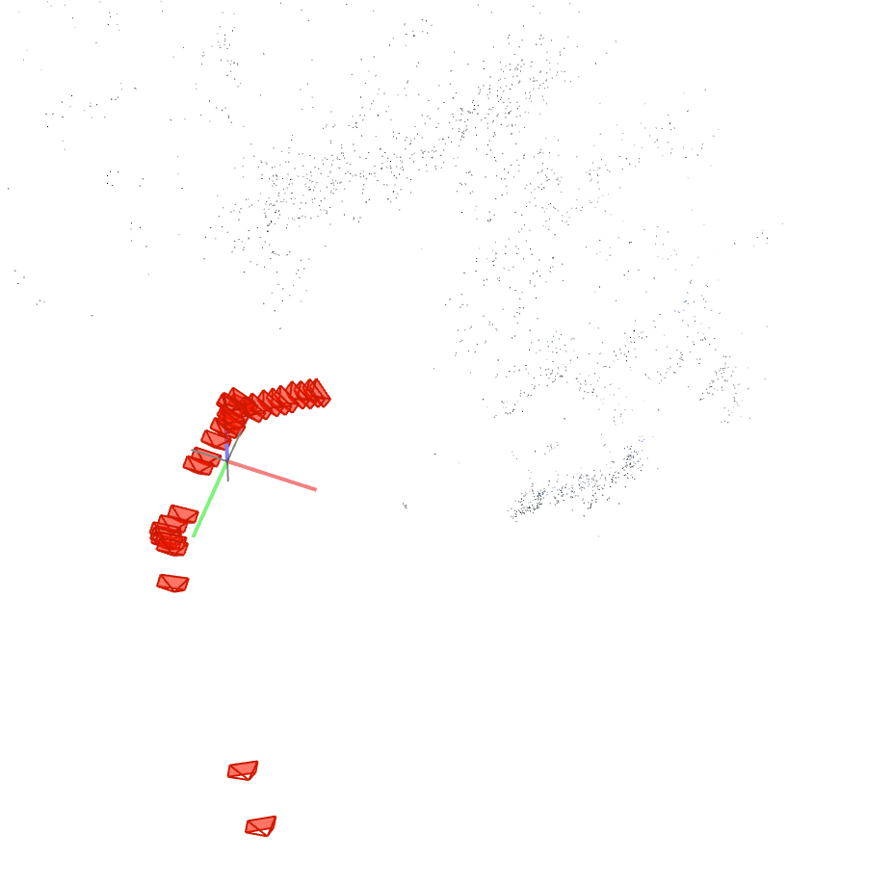
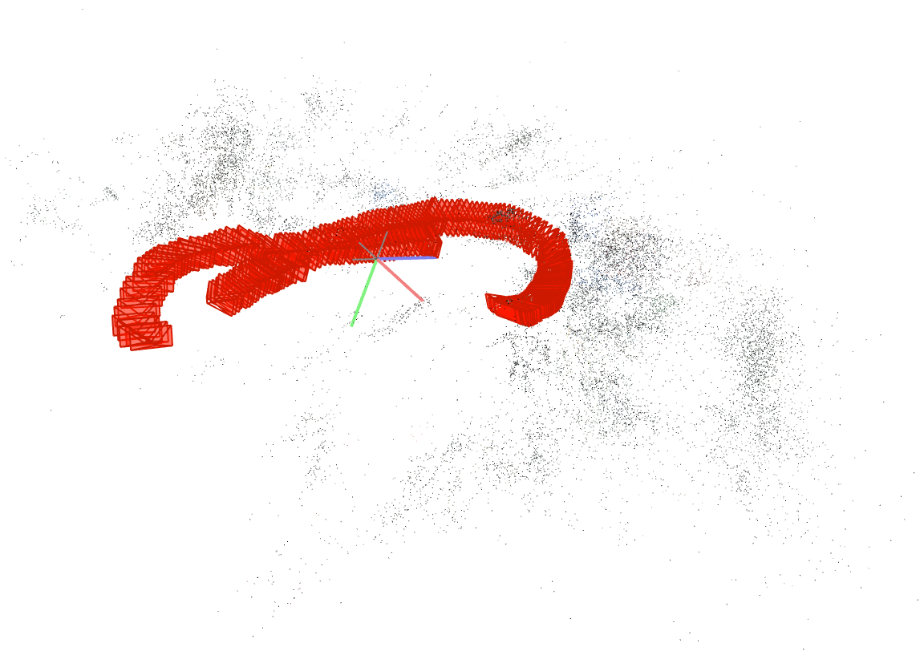
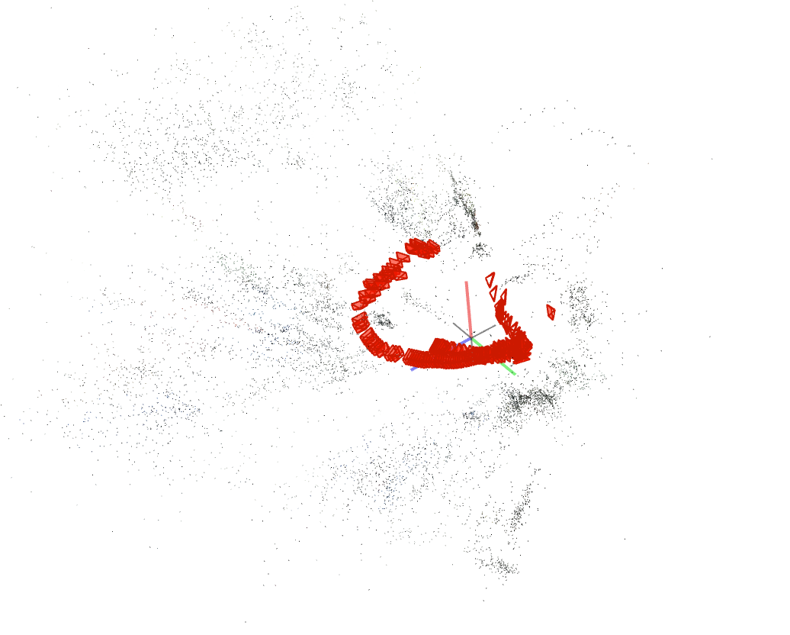
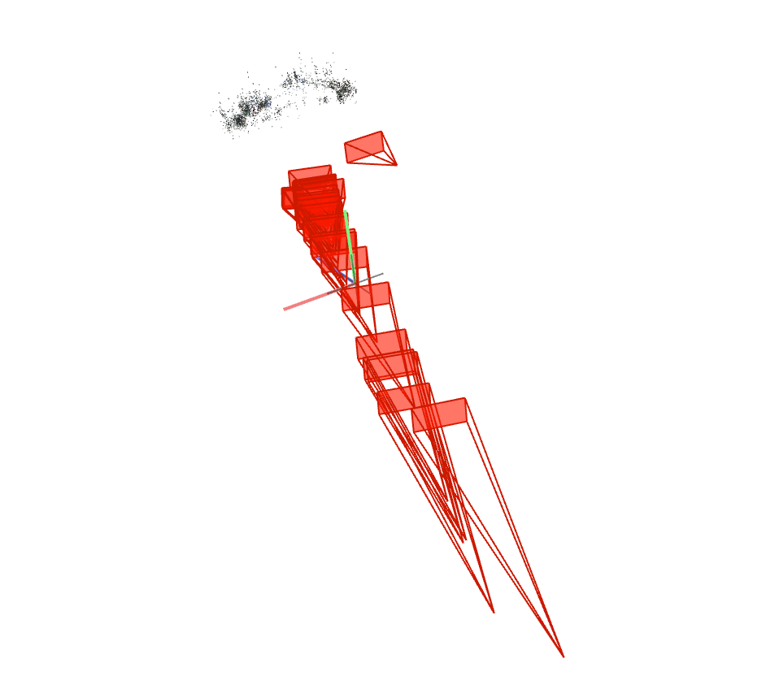
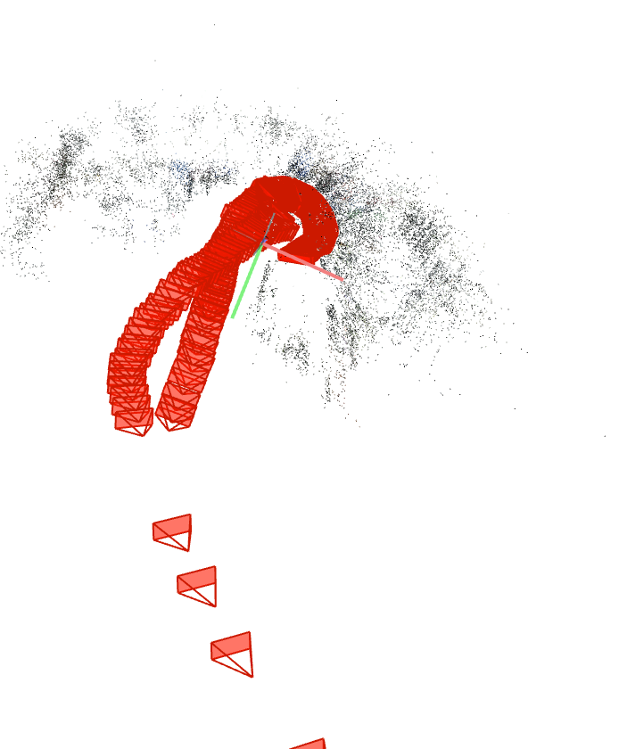
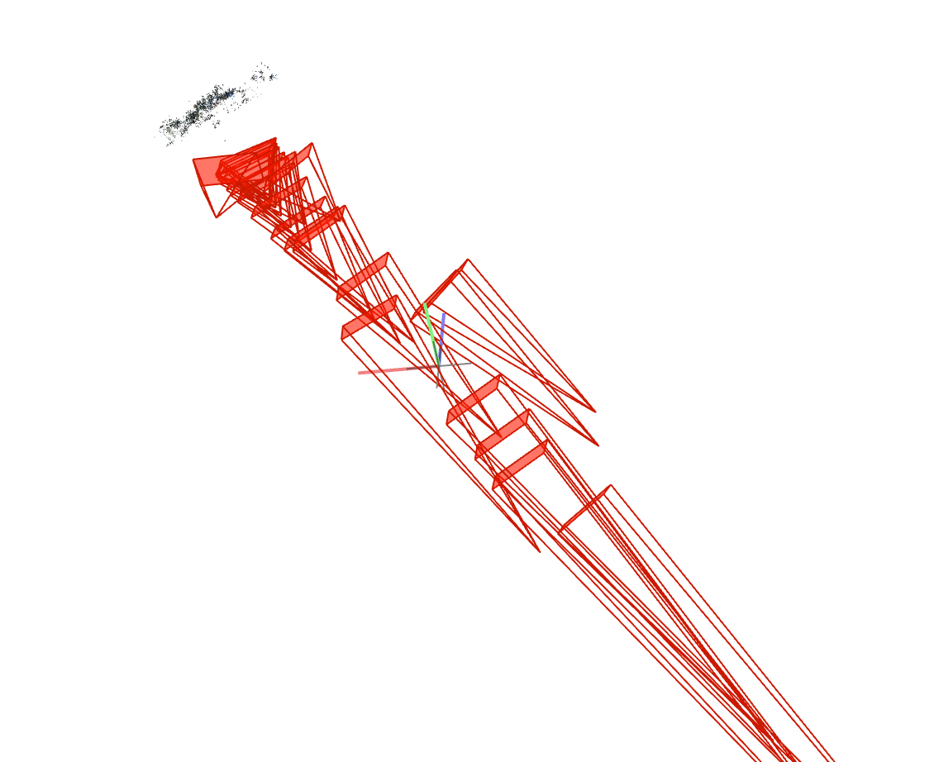
PREVIEW : CLOSE, 2000px
FOV 3 Sparse models | SIMPLE_RADIAL_FISHEYE 1 Sparse model | RADIAL_FISHEYE 2 Sparse models | OPENCV_FISHEYE 1 Sparse model | THIN_PRISM_FISHEYE 1 Sparse model

Slide 7
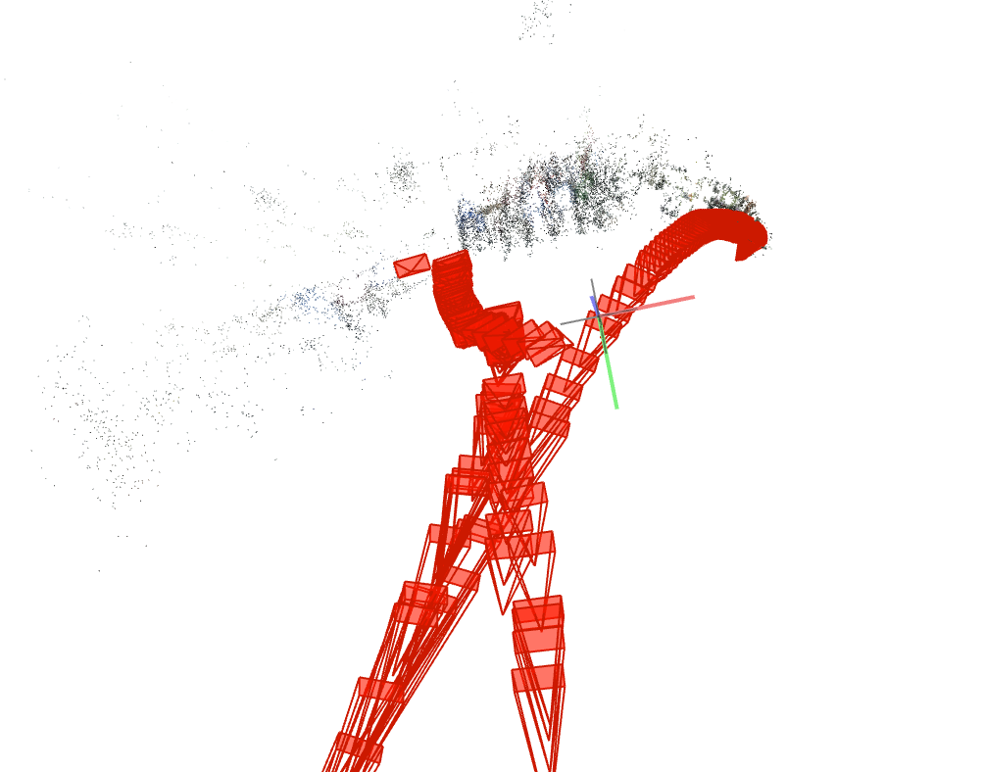
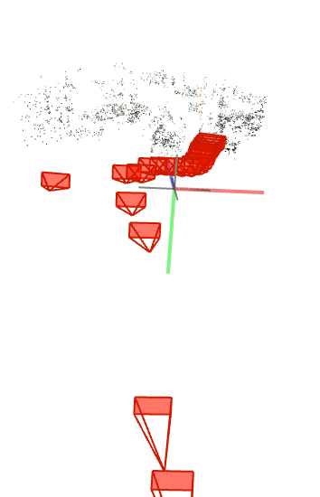
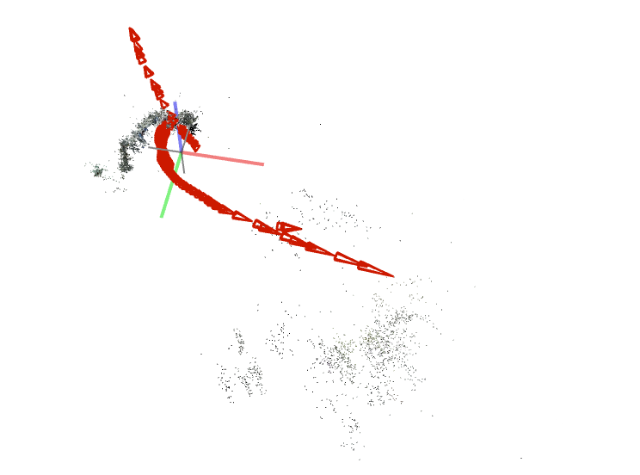
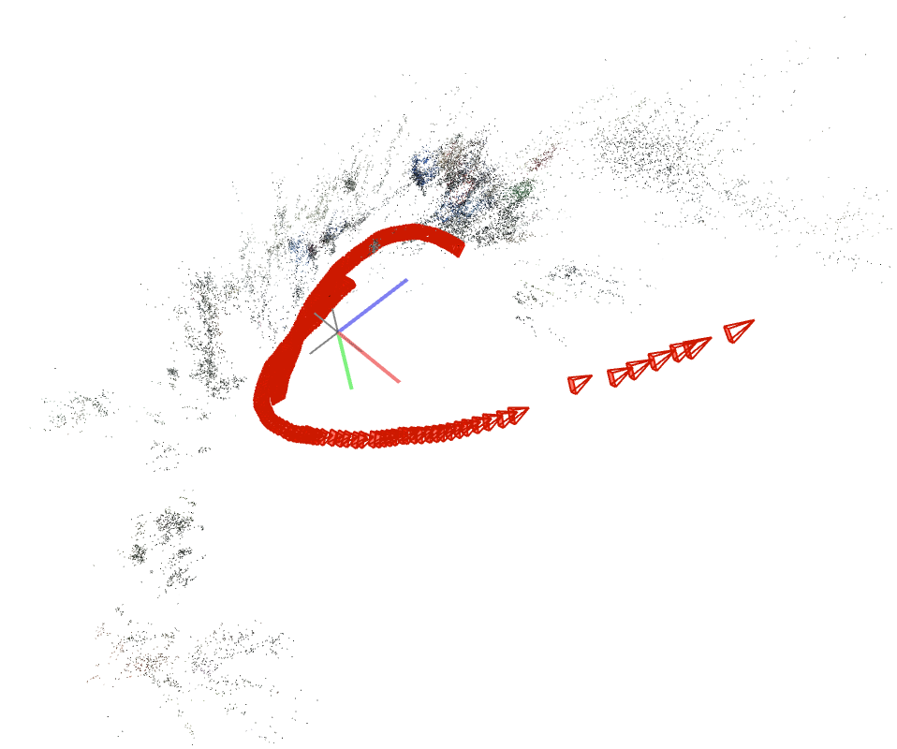
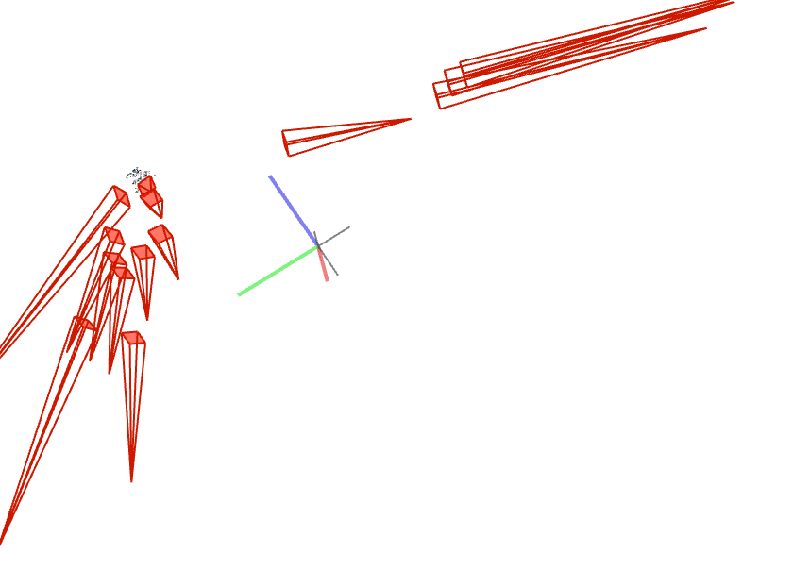
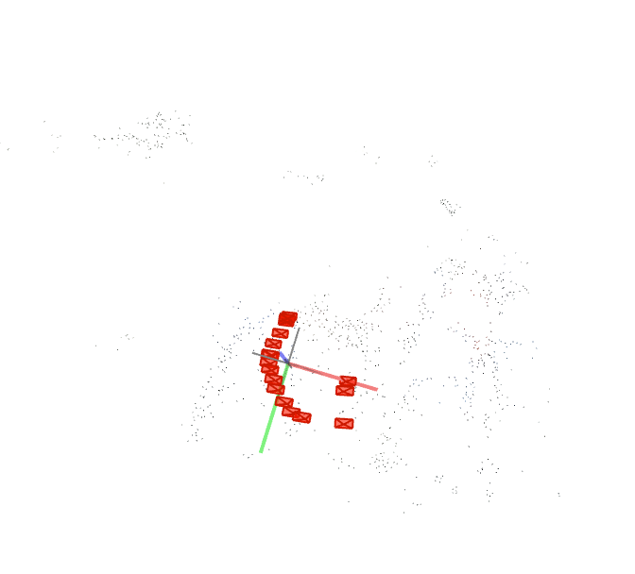
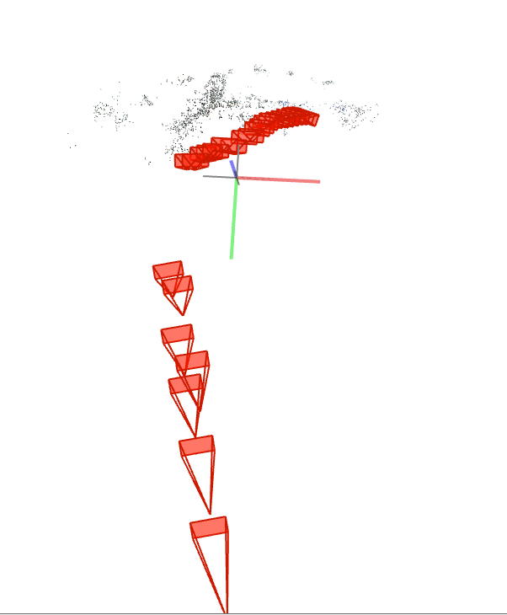
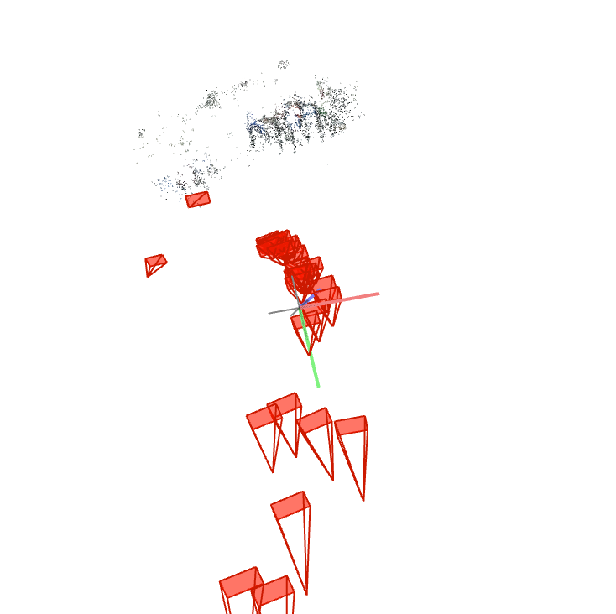
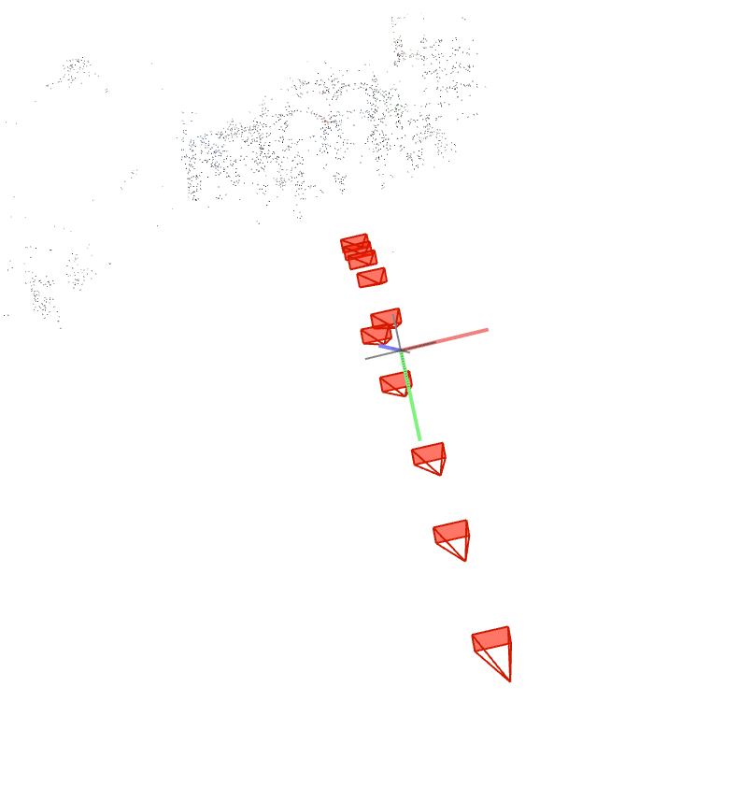
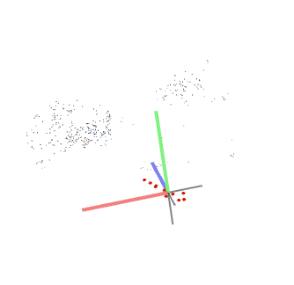
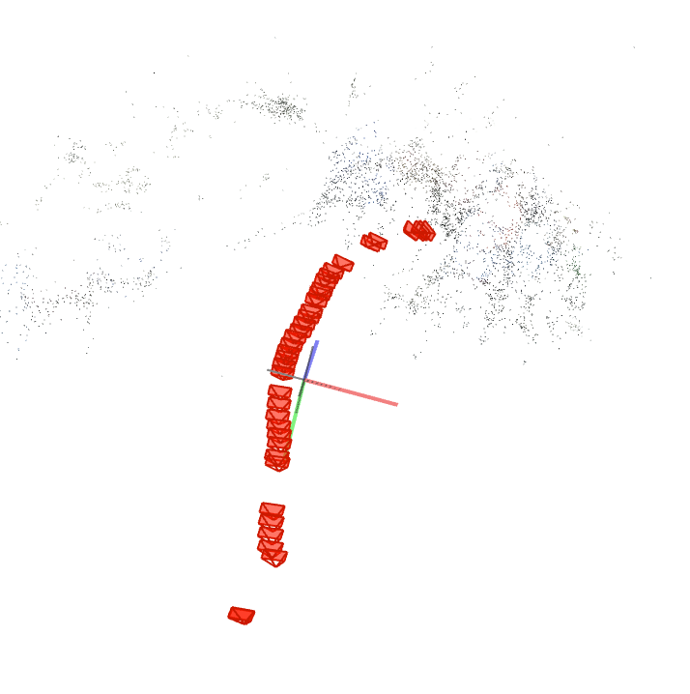
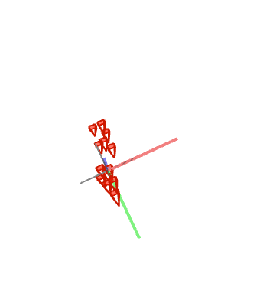
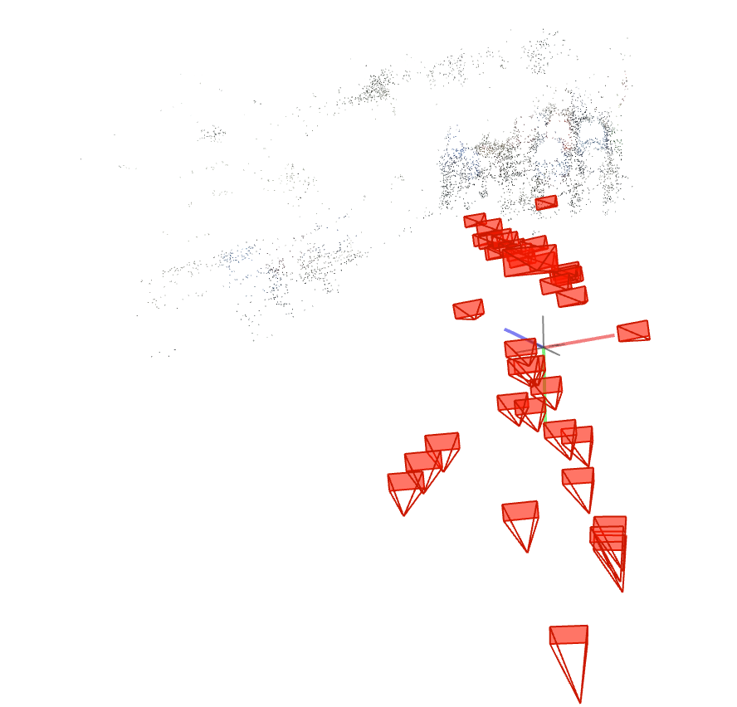
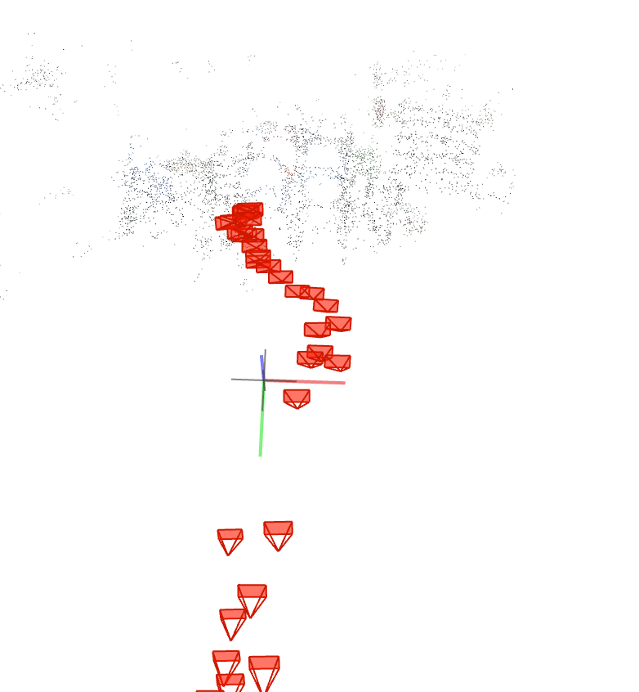
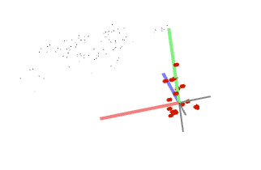

PREVIEW : CLOSE, 1000px
FOV 6 Sparse models | SIMPLE_RADIAL_FISHEYE 1 Sparse model | RADIAL_FISHEYE 3 Sparse models | OPENCV_FISHEYE | THIN_PRISM_FISHEYE

Slide 8
CONCLUSION
Retained Camera models: FOV, SIMPLE_RADIAL_FISHEYE
Increasing accuracy for larger frame size
Future work: (10 experiments): 2000px frames, 5 camera models, close and far, 30 FPS, double enclosed trajectory

Slide 9
Experiment 1
FPS : 10
# Frames : 295
Record length : 30 [s]
Camera distance model : FAR
Frame size : 1000
Camera model : FOV
Sparse models : 5

Slide 10
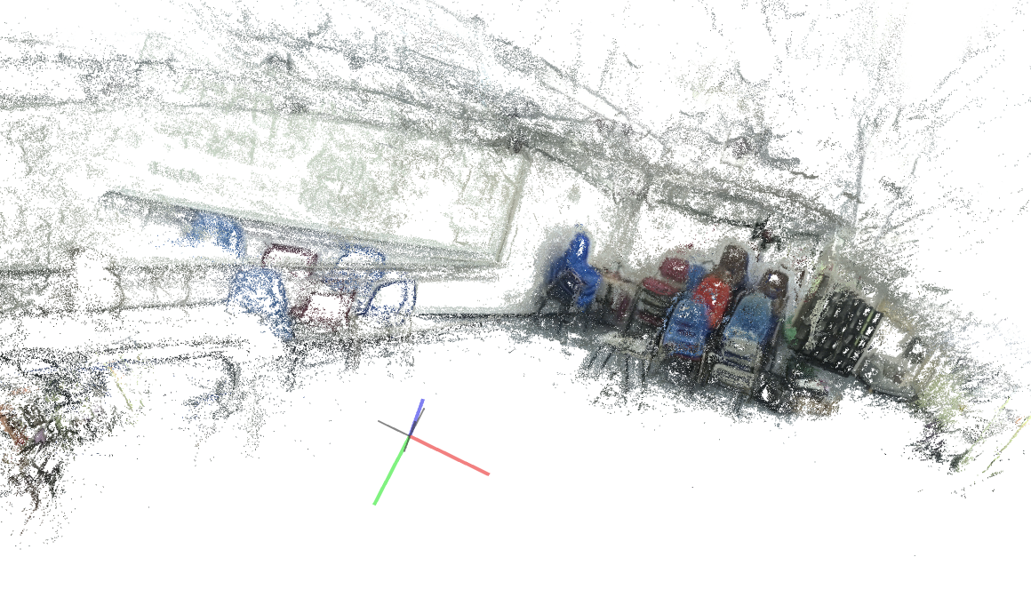

DENSE RECONSTRUCTION
FPS : 10
# Frames : 295
Record length : 30 [s]
Camera distance model : FAR
Frame size : 1000
Camera model : FOV

Slide 11
Experiment 2
FPS : 10
# Frames : 295
Record length : 30 [s]
Camera distance model : FAR
Frame size : 1000
Camera model : SIMPLE_RADIAL_FISHEYE

Slide 12






DENSE RECONSTRUCTION
FPS : 10
# Frames : 295
Record length : 30 [s]
Camera distance model : FAR
Frame size : 1000
Camera model : SIMPLE_RADIAL_FISHEYE
Scalling issues (see red drawings)

Slide 13
Experiment 3
FPS : 10
# Frames : 295
Record length : 30 [s]
Camera distance model : FAR
Frame size : 1000
Camera model : RADIAL_FISHEYE
Sparse models : 2 but one of the model contains all points

Slide 14

DENSE RECONSTRUCTION
FPS : 10
# Frames : 295
Record length : 30 [s]
Camera distance model : FAR
Frame size : 1000
Camera model : RADIAL_FISHEYE

Slide 15
Experiment 4
FPS : 10
# Frames : 295
Record length : 30 [s]
Camera distance model : FAR
Frame size : 1000
Camera model : OPENCV_FISHEYE
Sparse models : 7

Slide 16

DENSE RECONSTRUCTION
FPS : 10
# Frames : 295
Record length : 30 [s]
Camera distance model : FAR
Frame size : 1000
Camera model : OPENCV_FISHEYE

Slide 17
Experiment 5
FPS : 10
# Frames : 295
Record length : 30 [s]
Camera distance model : FAR
Frame size : 1000
Camera model : THIN_PRISMFISHEYE
Sparse model : 1

Slide 18

DENSE RECONSTRUCTION
FPS : 10
# Frames : 295
Record length : 30 [s]
Camera distance model : FAR
Frame size : 1000
Camera model : THIN_PRISMFISHEYE

Slide 19
Experiment 6
FPS : 10
# Frames : 295
Record length : 30 [s]
Camera distance model : FAR
Frame size : 2000
Camera model : FOV
Sparse model : 1

Slide 20




DENSE RECONSTRUCTION
FPS : 10
# Frames : 295
Record length : 30 [s]
Camera distance model : FAR
Frame size : 2000
Camera model : FOV

Slide 21

Experiment 7
FPS : 10
# Frames : 295
Record length : 30 [s]
Camera distance model : FAR
Frame size : 2000
Camera model : SIMPLE_RADIAL_FISHEYE Sparse model : 1

Slide 22



DENSE RECONSTRUCTION
FPS : 10
# Frames : 295
Record length : 30 [s]
Camera distance model : FAR
Frame size : 2000
Camera model : SIMPLE_RADIAL_FISHEYE

Slide 23
Experiment 8
FPS : 10
# Frames : 295
Record length : 30 [s]
Camera distance model : FAR
Frame size : 2000
Camera model : RADIAL_FISHEYE
Sparse model : 1

Slide 24



DENSE RECONSTRUCTION
FPS : 10
# Frames : 295
Record length : 30 [s]
Camera distance model : FAR
Frame size : 2000
Camera model : RADIAL_FISHEYE

Slide 25
Experiment 9
FPS : 10
# Frames : 295
Record length : 30 [s]
Camera distance model : FAR
Frame size : 2000
Camera model : OPENCV_FISHEYE
Sparse models : 4

Slide 26


DENSE RECONSTRUCTION
FPS : 10
# Frames : 295
Record length : 30 [s]
Camera distance model : FAR
Frame size : 2000
Camera model : RADIAL_FISHEYE

Slide 27
Experiment 10
FPS : 10
# Frames : 295
Record length : 30 [s]
Camera distance model : FAR
Frame size : 2000
Camera model : THIN_PRISMFISHEYE
Sparse models : 4

Slide 28

DENSE RECONSTRUCTION
FPS : 10
# Frames : 295
Record length : 30 [s]
Camera distance model : FAR
Frame size : 2000
Camera model : THIN_PRISMFISHEYE
FAILED TO RECONSTRUCT

Slide 29
Experiment 11
FPS : 10
# Frames : 295
Record length : 30 [s]
Camera distance model : CLOSE
Frame size : 1000
Camera model : FOV
Sparse models : 6

Slide 30


DENSE RECONSTRUCTION
FPS : 10
# Frames : 295
Record length : 30 [s]
Camera distance model : CLOSE
Frame size : 1000
Camera model : FOV

Slide 31
Experiment 12
FPS : 10
# Frames : 295
Record length : 30 [s]
Camera distance model : CLOSE
Frame size : 1000
Camera model : SIMPLE_RADIAL_FISHEYE
Sparse model : 1

Slide 32


DENSE RECONSTRUCTION
FPS : 10
# Frames : 295
Record length : 30 [s]
Camera distance model : CLOSE
Frame size : 1000
Camera model : SIMPLE_RADIAL_FISHEYE

Slide 33
Experiment 13
FPS : 10
# Frames : 295
Record length : 30 [s]
Camera distance model : CLOSE
Frame size : 1000
Camera model : RADIAL_FISHEYE
Sparse models : 3

Slide 34

DENSE RECONSTRUCTION
FPS : 10
# Frames : 295
Record length : 30 [s]
Camera distance model : CLOSE
Frame size : 1000
Camera model : RADIAL_FISHEYE

Slide 35
Experiment 14
FPS : 10
# Frames : 295
Record length : 30 [s]
Camera distance model : CLOSE
Frame size : 1000
Camera model : OPENCV_FISHEYE
Sparse models : 3

Slide 36

DENSE RECONSTRUCTION
FPS : 10
# Frames : 295
Record length : 30 [s]
Camera distance model : CLOSE
Frame size : 1000
Camera model : OPENCV_FISHEYE

Slide 37
Experiment 15
FPS : 10
# Frames : 295
Record length : 30 [s]
Camera distance model : CLOSE
Frame size : 1000
Camera model : THIN_PRISMFISHEYE
Sparse models : 2

Slide 38

DENSE RECONSTRUCTION
FPS : 10
# Frames : 295
Record length : 30 [s]
Camera distance model : CLOSE
Frame size : 1000
Camera model : THIN_PRISMFISHEYE

Slide 39
Experiment 16
FPS : 10
# Frames : 295
Record length : 30 [s]
Camera distance model : CLOSE
Frame size : 2000
Camera model : FOV
Sparse models : 3

Slide 40


DENSE RECONSTRUCTION
FPS : 10
# Frames : 295
Record length : 30 [s]
Camera distance model : CLOSE
Frame size : 2000
Camera model : FOV

Slide 41
Experiment 17
FPS : 10
# Frames : 295
Record length : 30 [s]
Camera distance model : CLOSE
Frame size : 2000
Camera model : SIMPLE_RADIAL_FISHEYE
Sparse model : 1

Slide 42




DENSE RECONSTRUCTION
FPS : 10
# Frames : 295
Record length : 30 [s]
Camera distance model : CLOSE
Frame size : 2000
Camera model : SIMPLE_RADIAL_FISHEYE

Slide 43
Experiment 18
FPS : 10
# Frames : 295
Record length : 30 [s]
Camera distance model : CLOSE
Frame size : 2000
Camera model : RADIAL_FISHEYE
Sparse models : 2

Slide 44




DENSE RECONSTRUCTION
FPS : 10
# Frames : 295
Record length : 30 [s]
Camera distance model : CLOSE
Frame size : 2000
Camera model : RADIAL_FISHEYE

Slide 45
Experiment 19
FPS : 10
# Frames : 295
Record length : 30 [s]
Camera distance model : CLOSE
Frame size : 2000
Camera model : OPENCV_FISHEYE
Sparse model : 1

Slide 46



DENSE RECONSTRUCTION
FPS : 10
# Frames : 295
Record length : 30 [s]
Camera distance model : CLOSE
Frame size : 2000
Camera model : OPENCV_FISHEYE

Slide 47
Experiment 20
FPS : 10
# Frames : 295
Record length : 30 [s]
Camera distance model : CLOSE
Frame size : 2000
Camera model : THIN_PRISMFISHEYE
Sparse model : 1

Slide 48



DENSE RECONSTRUCTION
FPS : 10
# Frames : 295
Record length : 30 [s]
Camera distance model : CLOSE
Frame size : 2000
Camera model : THIN_PRISMFISHEYE

Slide 49
APPENDIX: SCRIPTS USED
Colmap_experiment.sh
DATASET_PATH=$1
colmap feature_extractor --database_path $DATASET_PATH/database.db --image_path $DATASET_PATH/images --ImageReader.camera_model $2
colmap exhaustive_matcher \
--database_path $DATASET_PATH/database.db
mkdir $DATASET_PATH/sparse
colmap mapper \
--database_path $DATASET_PATH/database.db \
--image_path $DATASET_PATH/images \
--output_path $DATASET_PATH/sparse
mkdir $DATASET_PATH/dense
colmap image_undistorter \
--image_path $DATASET_PATH/images \
--input_path $DATASET_PATH/sparse/0 \
--output_path $DATASET_PATH/dense \
--output_type COLMAP \
--max_image_size 2000
colmap patch_match_stereo \
--workspace_path $DATASET_PATH/dense \
--workspace_format COLMAP \
--PatchMatchStereo.geom_consistency true
colmap stereo_fusion \
--workspace_path $DATASET_PATH/dense \
--workspace_format COLMAP \
--input_type geometric \
--output_path $DATASET_PATH/dense/fused.ply
colmap poisson_mesher \
--input_path $DATASET_PATH/dense/fused.ply \
--output_path $DATASET_PATH/dense/meshed-poisson.ply
colmap delaunay_mesher \
--input_path $DATASET_PATH/dense \
--output_path $DATASET_PATH/dense/meshed-delaunay.ply
Extract_frames.py
import sys
import os
import cv2
_VIDEO_PATH = sys.argv[2]
_FRAMES_DIR = sys.argv[3]
_OUTPUT_HEIGHT = 2160
_OUTPUT_WIDTH = 2 * _OUTPUT_HEIGHT
_FPS = int(sys.argv[1])
def main():
os.makedirs(_FRAMES_DIR, exist_ok=True)
cap = cv2.VideoCapture(_VIDEO_PATH)
frame_idx = -1
while True:
frame_idx += 1
cap.set(cv2.CAP_PROP_POS_MSEC,(frame_idx*(1000/_FPS))) #gets a frame every 1000[ms]/_FPS_
offset_ms = cap.get(cv2.CAP_PROP_POS_MSEC)
print(f"frame_{frame_idx:04}_FPS:{_FPS}.jpg")
ret, cur_frame = cap.read()
if not ret:
return
offset_ms = int(offset_ms)
cur_frame = cv2.resize(cur_frame, (_OUTPUT_WIDTH, _OUTPUT_HEIGHT))
output_path = os.path.join(_FRAMES_DIR, f"frame_{frame_idx:04}_FPS:{_FPS}.jpg")
cv2.imwrite(output_path, cur_frame)
if __name__ == "__main__":
main()

Slide 50
APPENDIX: SCRIPTS USED (2)
Crop_frames.py
Import sys
import os
import numpy as np
from PIL import Image
_FRAMES_DIR = sys.argv[3]
_CROP_DIR = sys.argv[4]
_FOV_WIDTH = np.radians(100)
_FOV_HEIGHT = np.radians(62)
_CROP_WIDTH = int(sys.argv[2])
_CROP_HEIGHT = int(round(np.tan(_FOV_HEIGHT/2) / np.tan(_FOV_WIDTH/2) * _CROP_WIDTH))
_FPS = int(sys.argv[1])
def crop_center(pil_img, crop_width, crop_height):
img_width, img_height = pil_img.size
return pil_img.crop(((img_width - crop_width) // 2,
(img_height - crop_height) // 2,
(img_width + crop_width) // 2,
(img_height + crop_height) // 2))
def main():
os.makedirs(_CROP_DIR, exist_ok=True)
fidx = -1
for file in sorted(os.listdir(_FRAMES_DIR)): # sorted() forcing python to keep the frame order, otherwise random
if file.endswith(".jpg"): # avoid working with hidden files
fidx += 1
print(fidx)
print(file)
frame = Image.open(os.path.join(_FRAMES_DIR, file))
rect = crop_center(frame, _CROP_WIDTH, _CROP_HEIGHT)
filename = (f"frame_{fidx:04}_FPS:{_FPS}_cropped.jpg")
file_path = os.path.join(_CROP_DIR, filename)
print(filename)
rect.save( file_path )
if __name__ == "__main__":
main()

